Slide 1

Apex Institute of Technology
Department of Computer Science & Engineering
Bachelor of Engineering (Computer Science & Engineering)
Design and Analysis of Algorithms– (20CSH-282)
Prepared By: Mr. Vikas Kumar (E13657)
DISCOVER . LEARN . EMPOWER

Slide 2
Content
Decrease and Conquer Approach
Topological Sort

Slide 3
Decrease and Conquer
Recursive in structure
Divide the problem into sub-problems that are similar to the original but smaller in size
Conquer the sub-problems by solving them recursively. If they are small enough, just solve them in a straightforward manner.
Combine the solutions to create a solution to the original problem

Slide 4
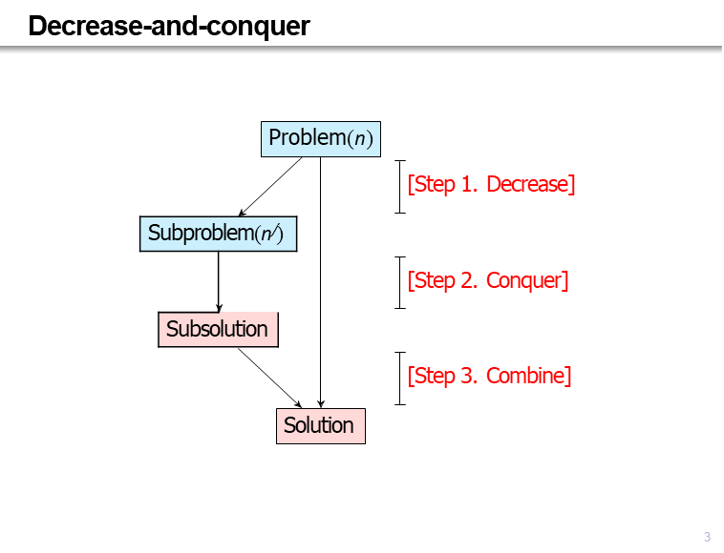
Decrease and Conquer

Slide 5
Decrease and Conquer:TYPES
Decrease by constant. n^{𝘫} = n − c for some constant c Decrease by constant factor. n^{𝘫} = n/c for some constant c Variable size decrease. n^{𝘫} = n − c for some variable c

Slide 6
Decrease By Constant
Size of the instance is reduced by the same constant in each iteration of the algorithm.
Decrease by 1 is common.
Examples:
Array sum
Array search
Find the maximum/minimum element
Integer product
Exponentiation
Topological sorting

Slide 7
Decrease By Constant Factor
The size of the instance is reduced by the same constant factor in each iteration of the algorithm
Decrease by factor 2 is common
Examples:
Binary search
Search/insert/delete in balanced search tree
Fake coin problem
Josephus problem

Slide 8
Variable Size Decrease
The size of the instance is reduced by a variable in each iteration of the algorithm
Examples:
Selection problem
Quicksort
Search/insert/delete in binary search tree
Interpolation search

Slide 9
Decrease and Conquer
Decrease by Constant

Slide 10
Decrease and Conquer
Problem:
Topological sorting of vertices of a directed acyclic graph is an ordering of the vertices v₁, v₂, . . . , v_{n} in such a way that there is an edge directed towards vertex v_{j} from vertex v_{i}, then v_{i} comes before v_{j} .

Slide 11
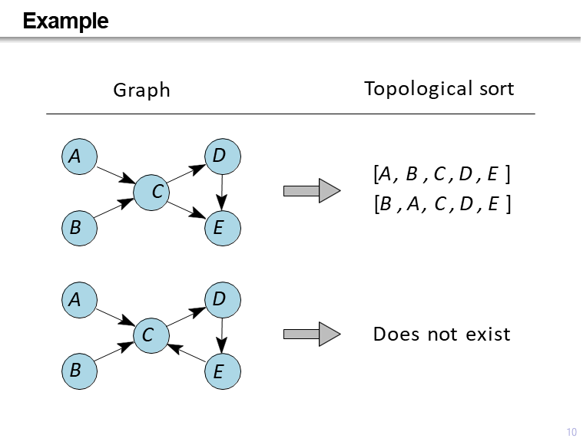
Decrease and Conquer

Slide 12
Decrease and Conquer
Topological sort = Reversal of the order in which the vertices become dead ends in the DFS algorithm.
TopologicalSort(G)
Topological sort T ← ∅
Mark each vertex in V as unvisited
for each vertex v in V do
if v is unvisited then
DFS(v)
return T
DFS(v)
Mark v as visited
for each vertex w in V adjacent to v do
if w is unvisited then
DFS(w)
T.AddFirst(v)

Slide 13
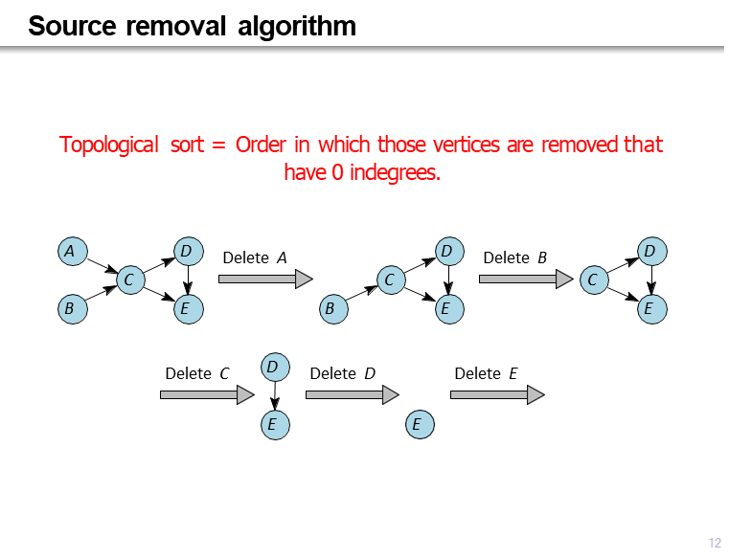
Decrease and Conquer

Slide 14
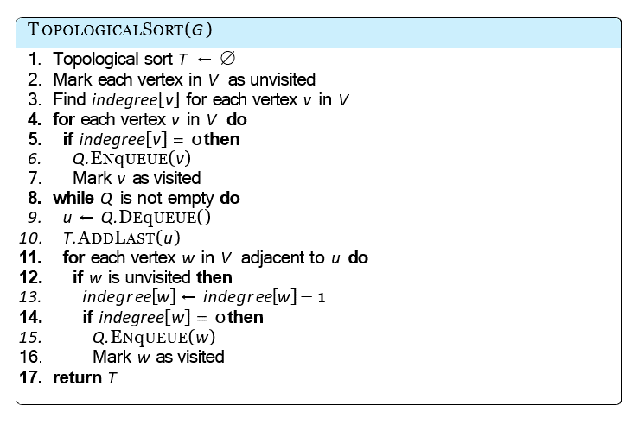
Decrease and Conquer

Slide 15
References
Fundamentals of Computer Algorithms 2nd Edition (2008) by Horowitz, Sahni and Rajasekaran
Introduction to Algorithms 3rd Edition (2012) by Thomas H Cormen, Charles E Lieserson, Ronald

Slide 16
THANK YOU
For queries
Email: vikash.e13657@cumail.in

